Slide 1
PHI KAPPA PSI
November 10, 2021

Slide 2
Meeting Agenda
-Officer Training Update - Devin
-Chapter News for Year in Review - Megan
-Scholarships – Elijah
-PCI - Oral History Project – Adam
-Founders Day – Adam
-Ritual Review Announcement – Timothy
-Member Roster Updates – Brandon
-Accreditation – Brandon
-Greek Life EDU/MA Agreements – Ben
-Elections – Ben
-Video participation – Drake

Slide 3
Leader Training Update
New look to Leader Training beginning in 2022!
Moving away from in person Regional Leadership Training (RLT) program
- Financial
- Time/Travel
- Attendees
- Staff & Volunteers
- Weather Challenges
- COVID-19 Restrictions
Virtual Experience - Building off 2021 virtual trainings
- Consistent Delivery
- Flexibility
- Able to revisit content throughout the year
- Train members as soon as they assume roles (mid-year)
- Create additional courses and resources as necessary

Slide 4
Leader Training Update
Assigned Courses:
Fall 2021: - Tightrope (Risk Management)
- Inclusive Practices (Diversity, Equity, & Inclusion Training)
- (Chapter Advisor Training Program also available)
Spring 2022:
- Officer 101
- Leadership Styles
- Leadership Skills Courses (I, II, & III)
- Individual Officer/Chair Tracks:
-President, Vice President, Corresponding Secretary, Treasurer,
Recruitment, Risk Manager, and (Fraternity Educator SU’ 22)

Slide 5
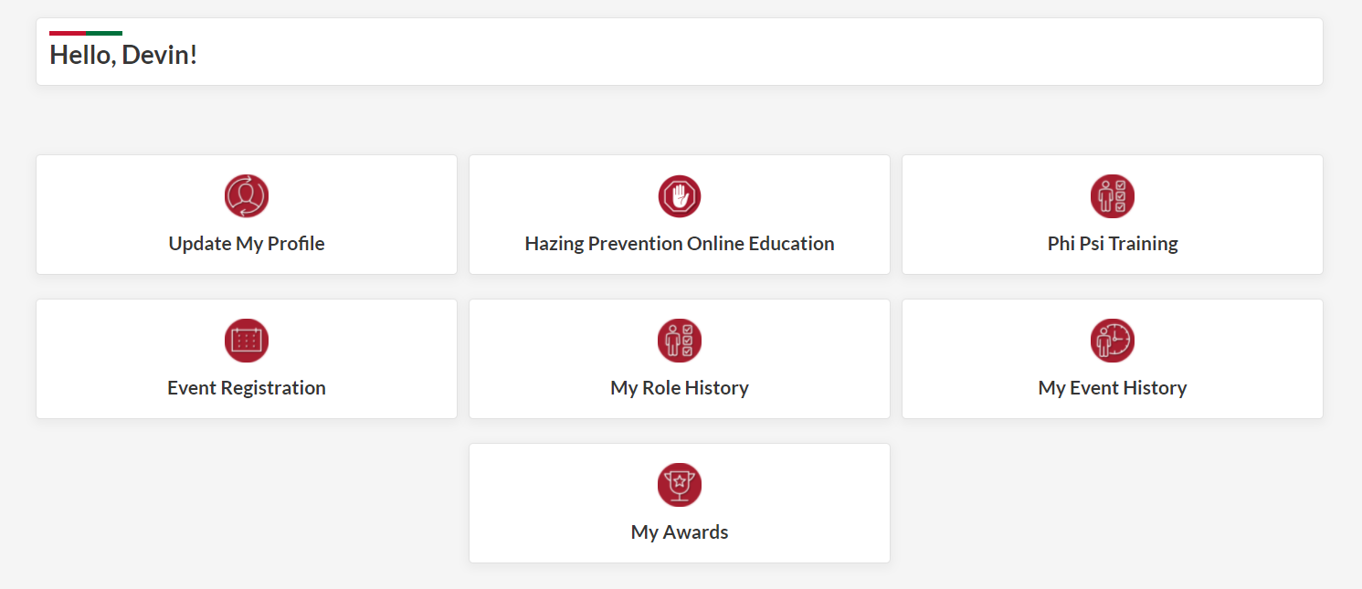
Leader Training Update – Accessing Training

Slide 6
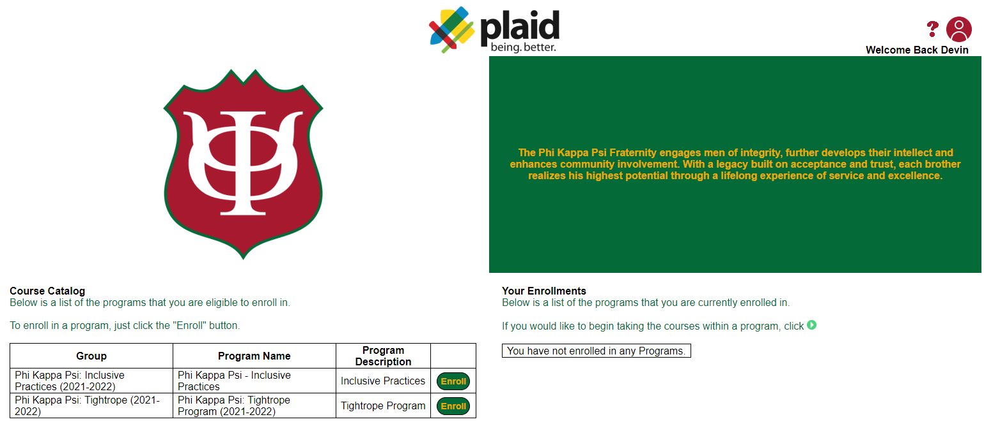
Leader Training Update – Course Catalog

Slide 7
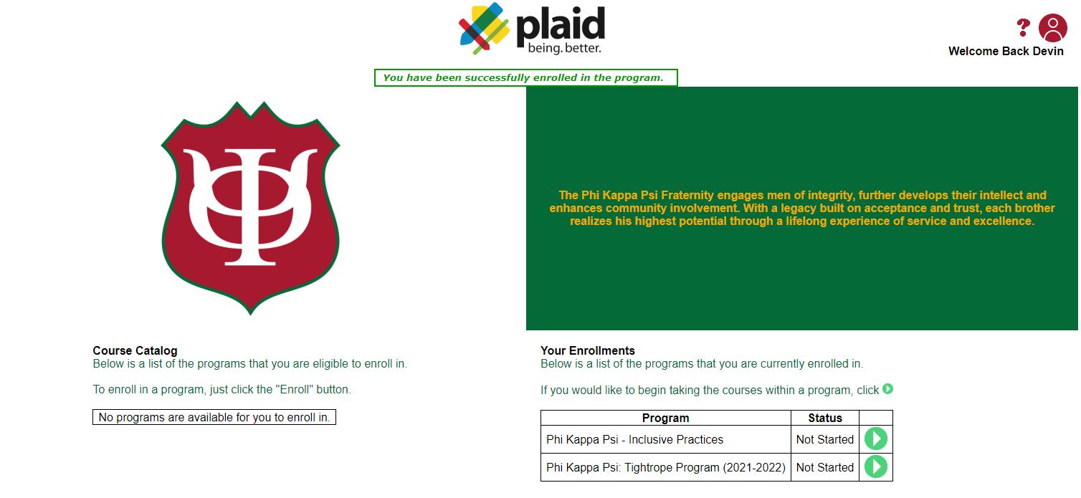
Leader Training Update – Course Enrollments

Slide 8
Chapter News
Please look out for emails from the communications team regarding submitting chapter news moving forward. This will be a consistent feature in our communications.
Alumni have voiced that they would like to see more about their chapters in future communications.
Please take a moment to type out in the chat the name of your chapter and an accomplishment from 2021 you would like to share with your alumni.
With your chapter news, if you have any pictures of the event or accomplishment that you can share, please send them to megan.diveto@pkpfoundation.org
We are always looking to feature our members and the great things that they do. I encourage everyone to reach out to the communications team anytime they have an accomplishment, an event, campus participation, or anything else they would like to share. This is your opportunity to showcase all the hard work your chapter does.

Slide 9
Chapter News-Have Not Received
University of Akron
University of Alabama
Allegheny College
Arizona State University
Ball State University
Beloit College
State University of New York at Binghamton
Brandeis University
State University of New York at Buffalo
Butler University
University of California, Berkeley
California Polytechnic State University
Capital University
University of Colorado
California State University, Northridge
University of Dayton
University of Delaware
Denison University
DePauw University
Drexel University
Franklin & Marshall College
Florida State University
University of Georgia
Georgia Institute of Technology
Gettysburg College
Houston Baptist University
University of Alabama in Huntsville
University of Illinois, Urbana-Champaign
Illinois State University
Indiana University
Indiana State University
James Madison University
Johns Hopkins University
University of Kansas
Kent State University
Lafayette College
Louisiana State University
Lycoming College
University of Maryland - College Park
University of Michigan
Michigan State University
University of Minnesota, Duluth
Minnesota State University, Mankato
University of Minnesota, Twin Cities
University of Missouri, Columbia
University of Mississippi
Monmouth University
Muskingum University
University of Nebraska
Northern Illinois University
Northwestern University
Ohio University
University of Mississippi
State University of New York College at Oneonta
University of Oregon
Oregon State University
University of Pennsylvania
Pennsylvania State University
Purdue University
Rochester Institute of Technology
Rowan University
Rutgers, The State University of New Jersey
San Diego State University
Stephen F. Austin State University
Southern Illinois University, Edwardsville
Stanford University
Syracuse University
University of Tennessee
University of Texas
Texas A&M University
Texas Tech University
University of Toledo
University of California, Davis
University of California, Irvine
University of Illinois, Chicago
University of Louisiana at Lafayette
University of the Sciences in Philadelphia
University of Utah
Valparaiso University
Virginia Commonwealth University
University of Virginia
Virginia Polytechnic Institute & State University
Washington & Jefferson College
Washington & Lee University
Wabash College
University of Washington
West Virginia University
Wittenberg University

Slide 10
Scholarship Update 2021-2022
Applications for National and District Scholarships are now open and will be due March 1, 2022, at 11:59 PM EST. To learn more about the awards and apply visit the Foundation's website.
Scholarships range from $1,000 to $7,500 and are made possible by the generosity of Foundation donors.
Be sure to work early so that you are able to spend enough time on your responses AND so your references have time to submit their portion of the application. You’ll need to have two references and late applications will not be considered.
For additional info on these or other scholarship and fellowship opportunities, or questions about the application process, contact scholarships@pkpfoundation.org.

Slide 11
Founders Day and Alumni Reminders
Phi Psi has partnered with PCI to conduct an alumni verification update and collect alumni stories as part of a Oral History Project. Alumni are encouraged to participate and can send questions to alumni@phikappapsi.com or visit our FAQ page at: https://www.phikappapsi.com/oral-history-project/
Share your Founders Day plans with us by emailing info to alumni@phikappapsi.com. If you’re planning an event for your chapter or in partnership with a local Alumni Association let us know so we can help promote it.

Slide 12
Ritual Review Announcement
- November 17th at 9:30p EST
- November 18th at 7:30p EST

Slide 14
Minimum Standards of Accreditation

Slide 15
Minimum Standards of Accreditation

Slide 16
Form Submissions

Slide 17
Form Submissions

Slide 18
Greek Life Edu and Membership Agreements
Membership Agreement
Alcohol Use in Chapter -Hazing
Illegal Drugs -Diversity and Non-Discrimination
Phi Psi Pledge to Live
Greek Life EDU
Part 1 -Part 2 (Available after 14 Day Intermission)
Membership Agreements Must be Complete Prior to Initiation
Tracking Available on Phi Psi Portal

Slide 19
Officer Elections and Roster Updates
Officer Elections
Nominations
Speeches
Discussion
Voting
Swearing In
Officer/Roster Updates
-Update New Officers in Roles Tab of Phi Psi Portal
-Receive Communication
-Allows Officer Permissions
-New Members
-Alumni

Slide 20
Upcoming Monthly Meetings
Wednesday December 8th
Links to register for each call located on Website

Slide 21
PHI KAPPA PSI QUESTIONS?

